Slide 1

Delivery Management System

Slide 2
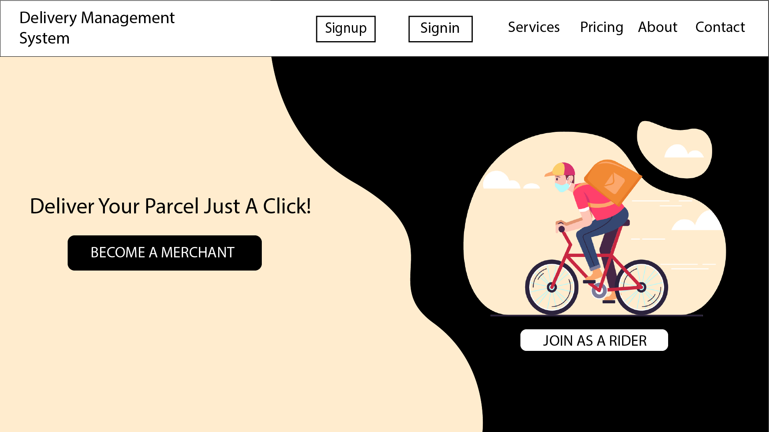
Public Mode

Slide 3
User/Merchant Mode
Register
Login
Pickup Request (Send request to Rider based on location )
Check Own Running Delivery
Check Own All Delivery History
Check Balance & Payment History
Logout

Slide 4
Delivery Man/Rider Mode
Login
Accept Delivery Request (Based on location)
Pickup Parcel
Drop Parcel
Check Running Delivery
Check Own Completed Delivery
Check Balance
Logout

Slide 5
Branch/Zone Manager Mode
Login
Add Delivery Man
Check All Running Delivery Of Own Branch
Check All Completed Delivery Of Own Branch
Check Riders Bill
Pay Riders Bill
Logout

Slide 6
Admin Mode
Login
Add Branch
Add Branch Manager
New Merchant Registration Confirm
Check All Running Delivery Of All Branch
Check All Completed Delivery Of All Branch
Payment Bill of Merchant.
Check Balance & Payment History
Logout

Slide 7
Feasibility Analysis
Operational:
A merchant can send a parcel pickup request which will go to Riders of this zone.
A rider can accept pickup request and he will drop it to destination. Rider will take cash from destination customar and he will give it to zone manager.
Manager will add rider and pay bill of rider, he will control own zone delivery.
Admin have all super power, he have control of all zone delivery. He can give payment of merchant.

Slide 8
Technical:
We will use Python web framework Django in Backend development, which is very secured, fast, and scalable web framework.
We will use PostgreeSQL in Database development, which is perfect relational database for Django web framework with some special feature.
We will use HTML, CSS, Jquery and React JS for frontend Design, React JS is popular frontend development library which is very fast and have amazing features.

Slide 9
Economical:
We will use extreme programming which will reduce our development time and cost also.

